Slide 1
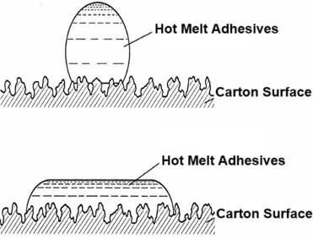
Application Product
Using hot melt adhesives for carton sealing is a packaging method that employs hot melt adhesives as the sealing material to close cardboard boxes. It ensures a strong bond, preventing the boxes from easily splitting during transportation and storage. The quick setting time enhances packaging efficiency, making it suitable for large-scale automated packaging production lines.
UNISN Carton Sealing Hot Melt Adhesives are primarily used in: The hot melt adhesive machine heats the solid adhesive to a molten state, then applies the liquid adhesive evenly to the carton's sealing flaps using a glue gun or nozzle. After closing the flaps, the adhesive cools and solidifies, creating a strong and secure seal.

Slide 2
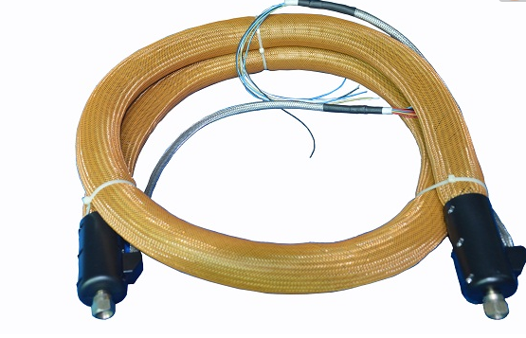
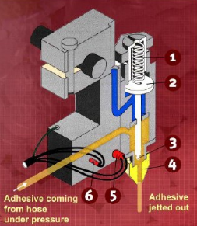
Application Equipment
Hot Melt Adhesive Machine (includes melting tank, power and control circuits, pump body, and manifold)
Melting, storing, and transferring hot melt adhesives; temperature control.
Hose (includes thermostat, heater, spray gun power cord, etc.)
Insulated delivery and pressure transmission.
Spray Gun (includes heating elements, nozzle, flow and temperature adjustment devices)
Controls adhesive volume, spraying or extrusion, triggering, and operation.

Slide 3
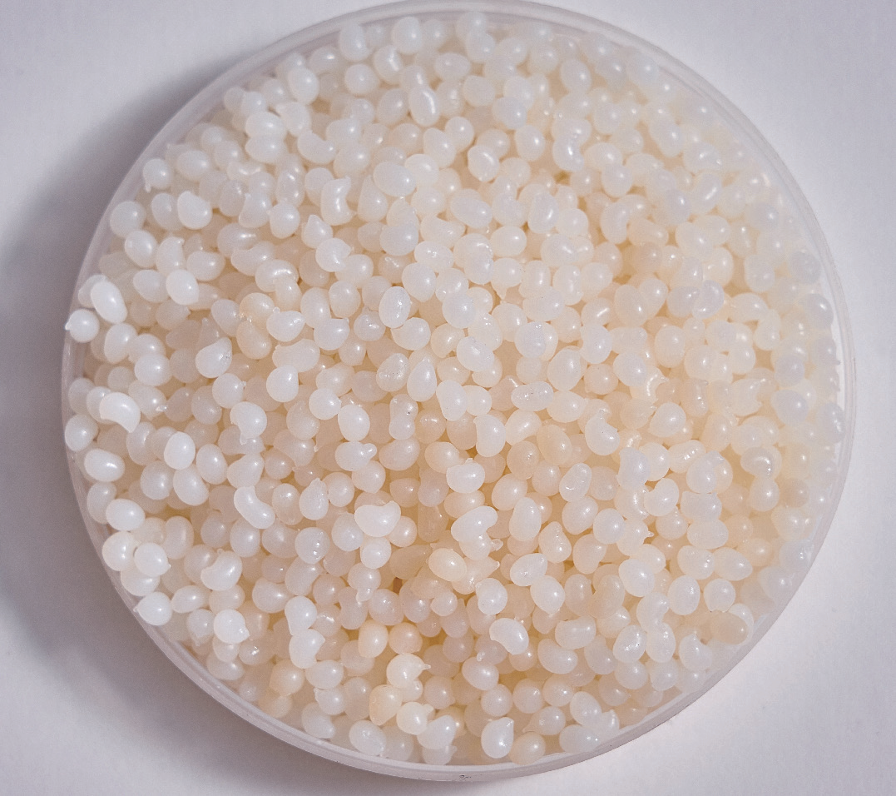
Why Choose UNISN Hot Melt Adhesives?
Comprehensive Product Range: Offers solutions tailored to different application environments and conditions, balancing quality and cost-effectiveness.
Viscosity: Adapts to various equipment for quick and even application, ensuring a complete bond.
Curing Speed: Matches the pressing cycle of equipment, enabling rapid fixation and significantly shortening production cycles.
High Bonding Strength: Provides excellent adhesion to various packaging materials, ensuring durability.
Temperature Resistance: Maintains strong bonding strength and stability across different temperature environments.
Cost-Effective: Delivers lower-cost solutions while meeting performance requirements.
Quality Assurance: Laboratory-tested under extreme conditions to ensure consistent and reliable quality.
Eco-Friendly: Made from environmentally safe materials, harmless to human health and the environment. Suitable for industries with high environmental standards.

Slide 4
Usage and Precautions
Open Time: 1-30 seconds
Temperature Settings:
Melting Tank: 160-180°C
Hose and Spray Gun: 150-175°C
Maintenance Recommendations
Weekly: Check connections. Inspect the compressed air filter bowl. Drain adhesive residue.
Quarterly: Drain adhesive to remove carbon deposits from the manifold.
Biannually: Inspect/replace the filter screen.
As Needed: Replace the spray gun body, nozzle, and filter screen, and clean the adhesive machine.
Precautions
1. Do not exceed 180°C when heating.
2. Avoid mixing different types of hot melt adhesives.
3. Wear gloves and safety goggles or a face shield when adding adhesive or performing maintenance.
4. Add materials carefully to prevent splashing and burns.
5. Maintain proper adhesive levels to avoid splashing during refilling.
6. Keep a bucket of cold water nearby for immediate treatment in case of burns.
7. Position the adhesive machine and related equipment below eye level.

Slide 5
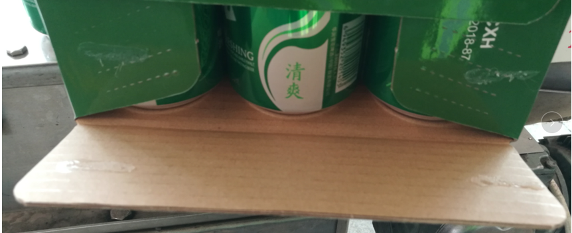
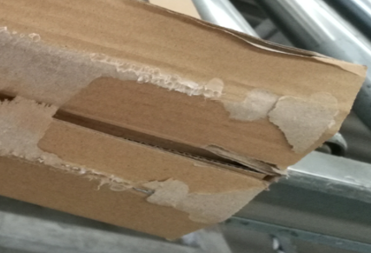
FAQ
Production Anomaly | Cause Analysis | Solutions
Weak adhesion, box opening | Inadequate glue dissolution | Increase the dissolution temperature and add glue in a timely manner
 | Insufficient glue application | Increase the glue spraying pressure
 | Thick ink on the carton | Ensure the consistency of carton quality / Select a suitable carton - sealing adhesive
 | Non-standard carton size and specifications | Ensure the consistency of carton quality
 | Long curing time | Select a suitable carton - sealing adhesive
 | Long open time | Adjust the pressing time / Select a suitable carton - sealing adhesive
Damaged or unqualified materials | Thick ink | Ensure the consistency of carton quality and select a suitable carton - sealing adhesive
 | Cohesion issues | Select a suitable carton - sealing adhesive
 | External environment influence | Check if the pressing is in place

Slide 6
FAQ
Production Anomaly | Cause Analysis | Solutions
Carbonization | Foreign matter entering | Ensure the packaging bag is intact, and the addition container is clean and sealed
 | Excessive operating temperature | Appropriately reduce the temperature of the glue tank/hose/gun
 | Low glue volume in the glue tank | Add glue on time
Stringing | High glue temperature | Appropriately reduce the temperature of the glue tank/hose/gun
 | Low glue viscosity | Select a suitable carton - sealing adhesive
 | Mismatch between glue - spraying time and carton conveying speed | Adjust the glue - spraying time / carton conveying rhythm
 | Poor thermal stability | Select a suitable carton - sealing adhesive
 | Burrs on the equipment nozzle | Replace the nozzle with a burr - free one

Slide 7
FAQ
Production Anomaly | Cause Analysis | Solutions
No glue spraying, low glue - spraying volume | Inadequate glue dissolution | Increase the dissolution temperature and add glue on time
 | Clogged nozzle | Unclog the nozzle
 | Low glue - spraying pressure | Increase the glue - spraying pressure
Foaming in the glue pot | Moisture in the glue tank | Avoid external water splashing into the glue tank / Ensure the packaging bag is intact
 | Raw material problems | Select a suitable carton - sealing adhesive

Slide 8
Thank You for Your Attention!
Sichuan UNISN New Material Technology Co., Ltd.
Office Address: Room 806, Building 5, China Railway West City Business District, Qingyang District, Chengdu,
Sichuan Province,
China
Tel: +86 028-81726336 Fax: +86 028-81766336
Mobile: +86 138 8208 4297 Email: unisn@foxmail.com

